Slide 1
Instant Notice Motion Sensor
LED Strip Light
YI-CHEN CHEN
N11564628

Slide 2
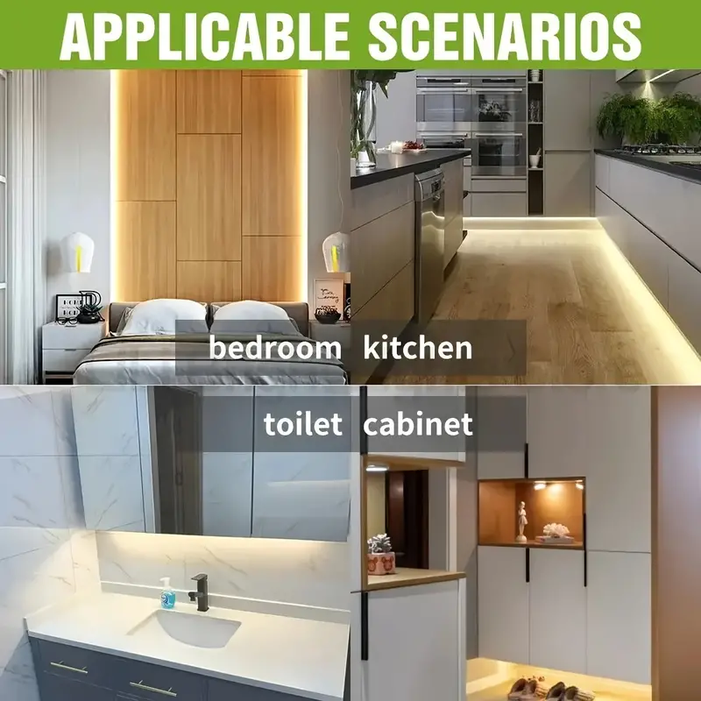
Project Overview
what will the project do, how will you do it, why is it important
Victual machine
Microcontroller
Embedded
Sensors

Slide 3
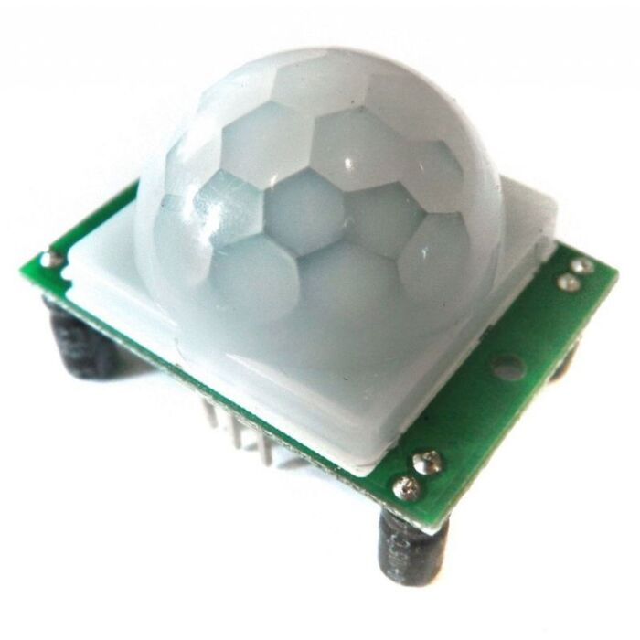
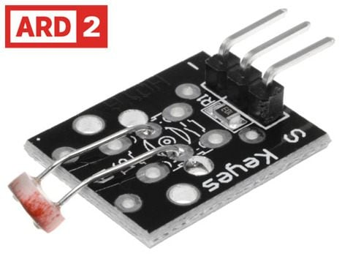
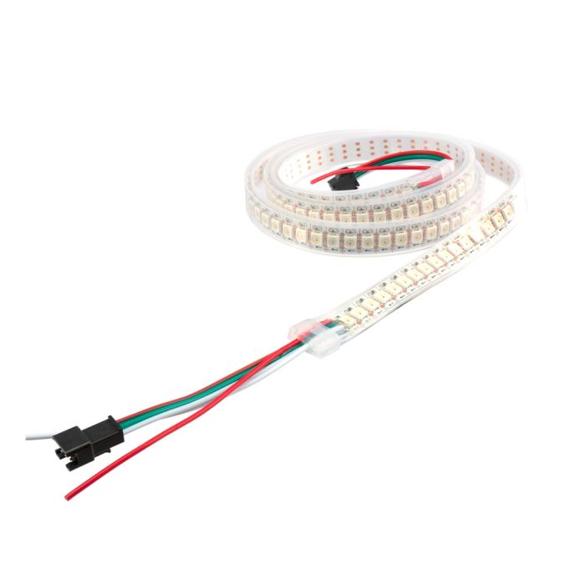
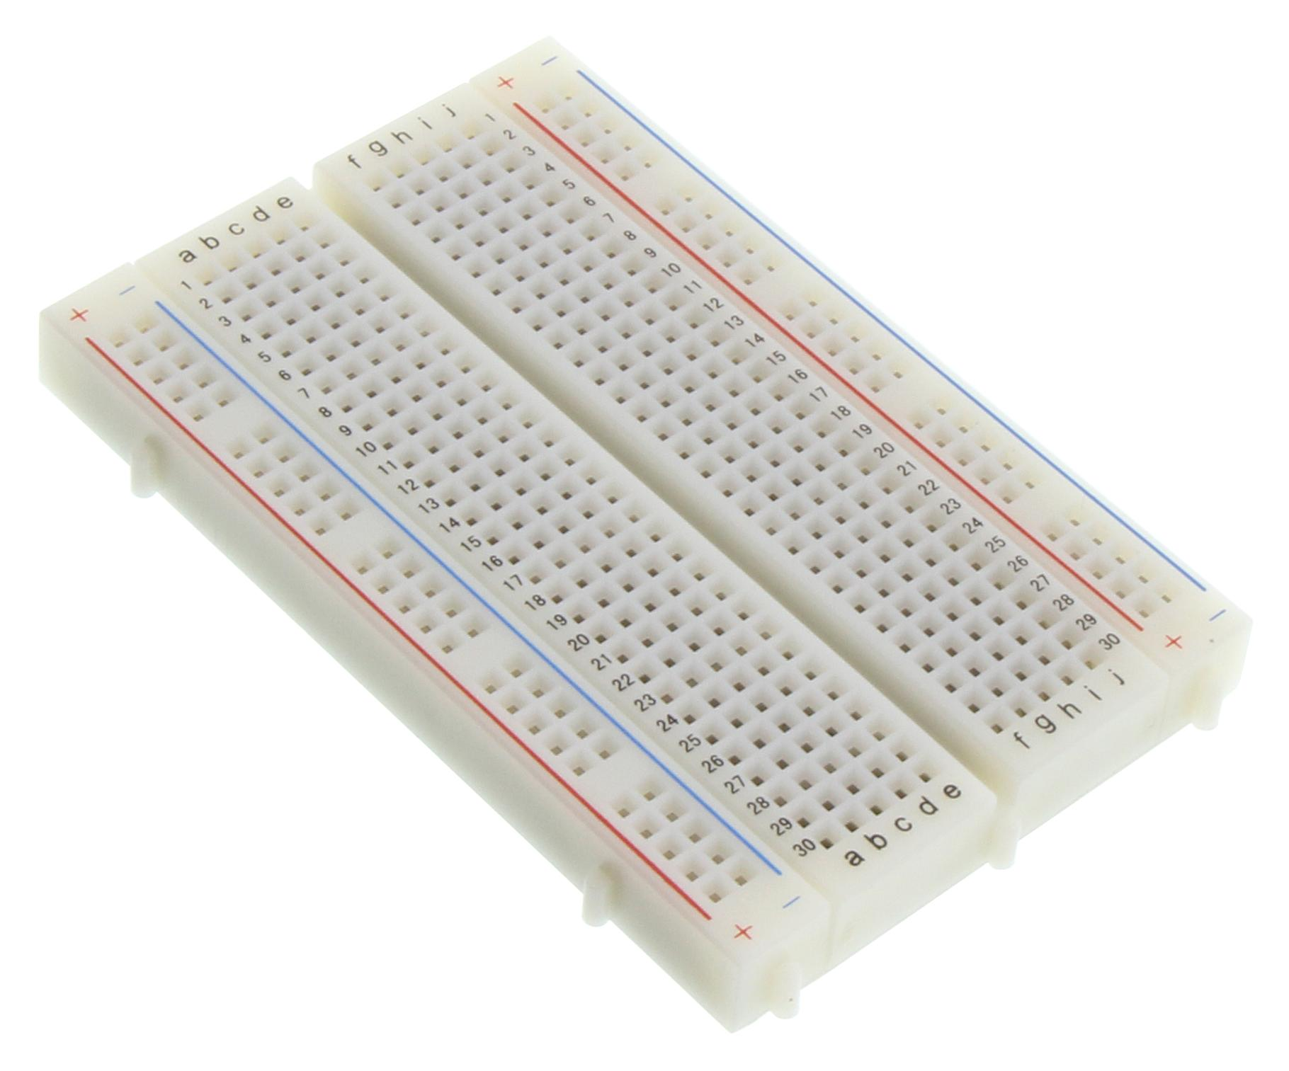
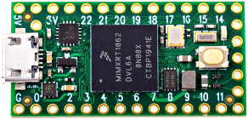
Tier 1 Design
PIR → Teensy
LDR → Teensy
Teensy → WS2812
LDR Light Sensor (ARD2-2218)
Passive Infrared (PIR) Motion Sensor
Bread board
Teensy board 2.0
WS2812b (RGB LED Strips)

Slide 4
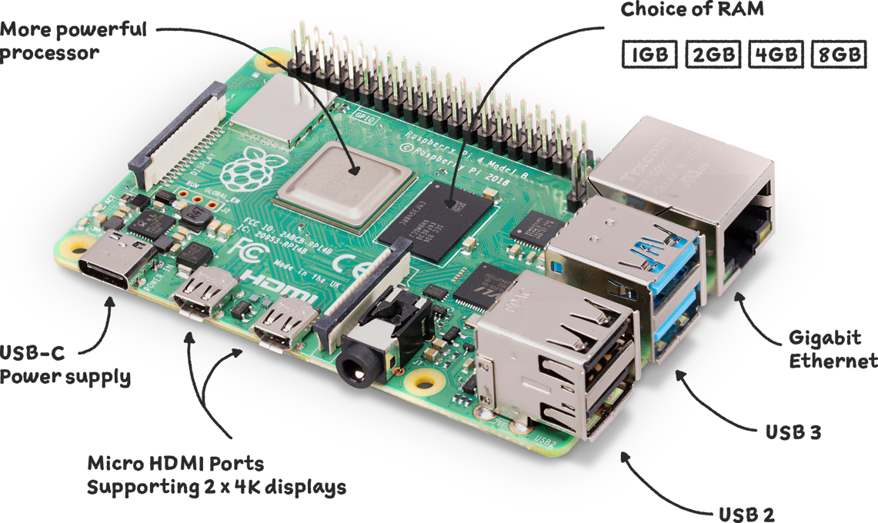





Tier 2 Design
Teensy → Raspberry Pi
Raspberry Pi → AWS EC2 (via MQTT)
Raspberry Pi → LED control

Slide 5



Tier 3 Design
details about how you desing/implement the cloud tier and user interface
MQTT Server
MQTT Client

Slide 6
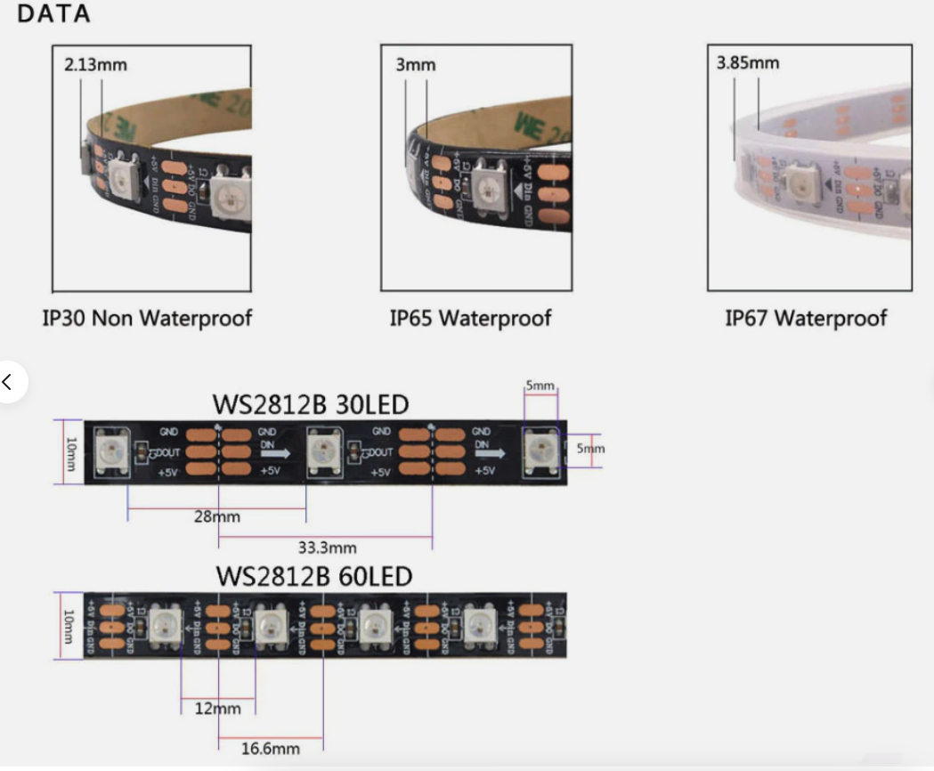
Design Considerations

Slide 7
Methodology
Measure my ability
Just do it
Watch relevant videos
Buy and borrow essential sensors
Review tutorial slides

Slide 8
Reference
Ramachandran, G., & Jurdak, R. (2023). IFN649 Advanced Networks Lecture Notes [PDF document]. Queensland University of Technology.
World Semi. (n.d.). WS2812 VS WS2812B. https://cdn.sparkfun.com/assets/learn_tutorials/1/0/5/WS2812B_VS_WS2812.pdf

